Slide 1
UNSUPERVISED MACHINE LEARNING
TING CHONG NA
28.05.2023

Slide 2
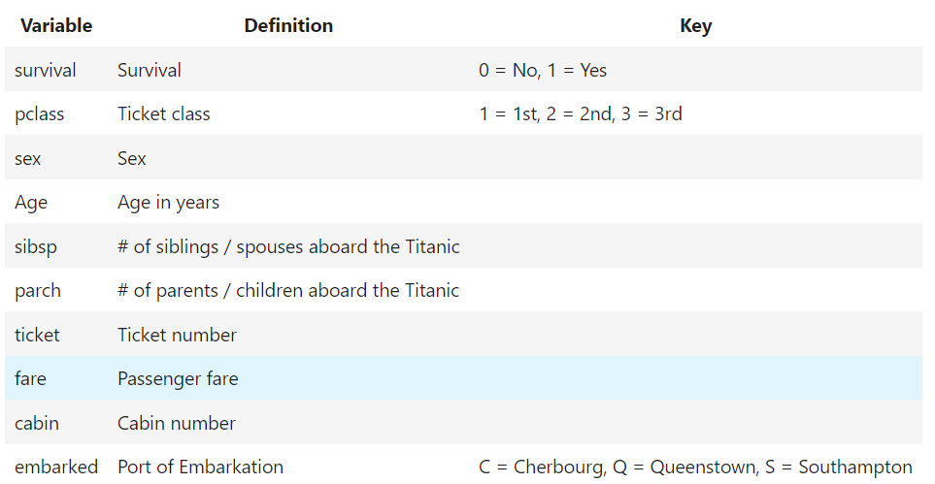
Data Description
TOPIC: Titanic Dataset
Objective: Determine if there is a relationship between survival and the different clusters
On April 15, 1912, the Titanic collided with an iceberg and sank. When the Titanic sank, it killed 1502 out of 2224 passengers and crew.

Slide 3
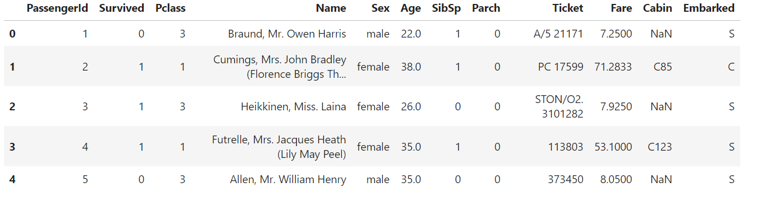
Data Preprocessing
Original Dataset
Drop columns
Deal with missing values
Standardize data
Feature Binarization

Slide 4
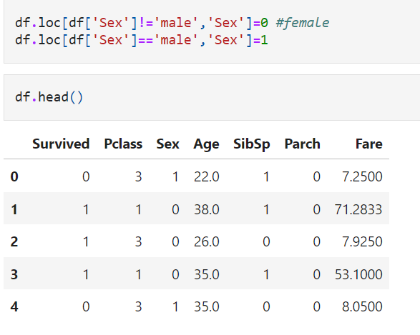
Data Preprocessing
Eg: Name, Ticket, Cabin, PassengerID, Embarked
DROP COLUMN
Assign "0" to "female" sex, and "1" to "male" sex,
FEATURE BINARIZATION

Slide 5
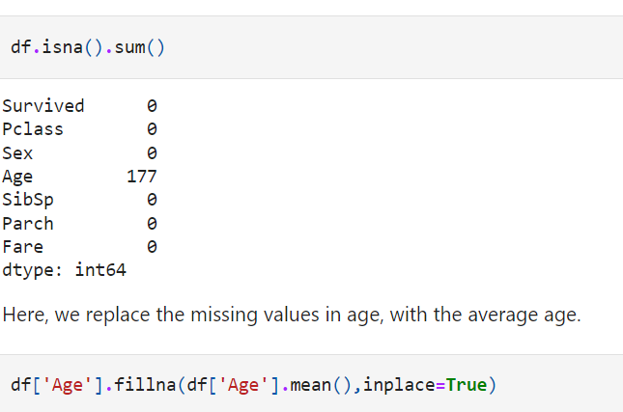
Data Preprocessing
Check for missing values
DEALING WITH MISSING VALUES
Replace the missing values in age,
with the average age.

Slide 6
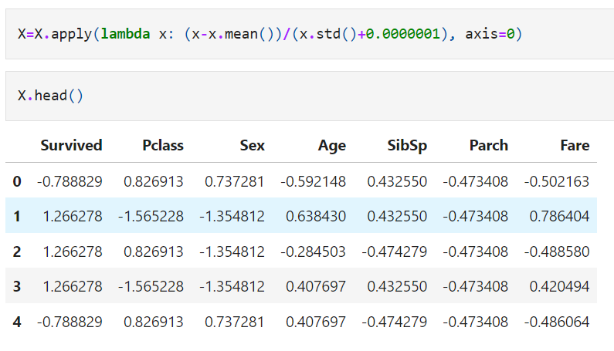
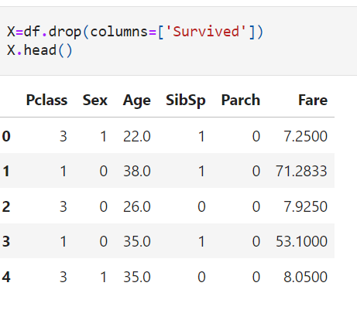
Data Preprocessing
SANDARDIZE DATA X
Assign the dataframe to X, for clustering,
and drop our target,the Survival column.
Standardize the data X

Slide 7
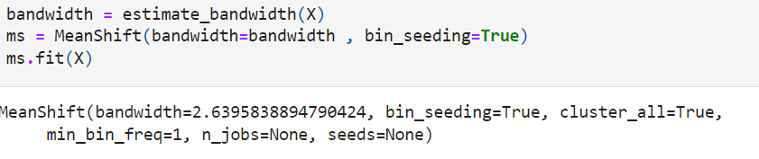
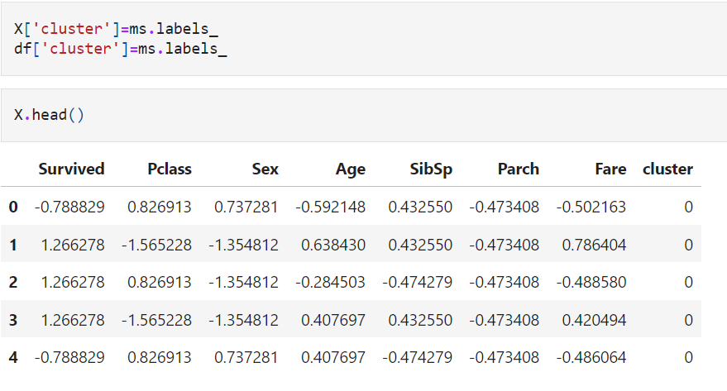
Model: Mean Shift
Apply the Mean-Shift algorithm to X
Apply the clusters for analysis

Slide 8
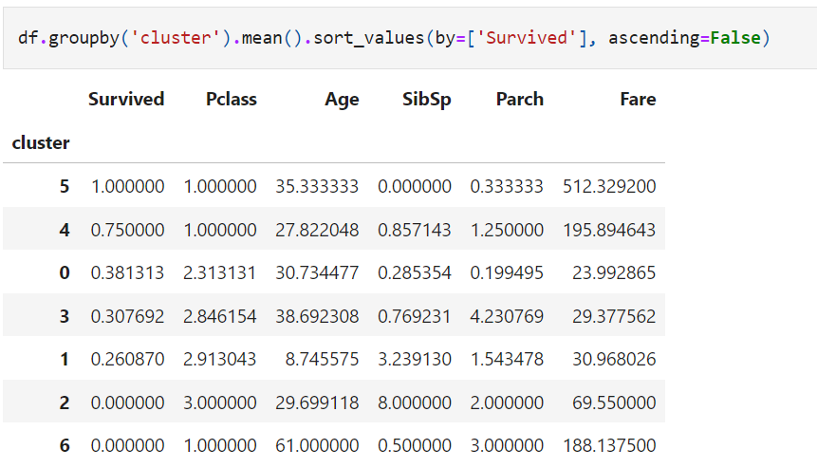
Model: Mean Shift
Group by clusters, to see that certain clusters have a larger chance of survival

Slide 9
Model: Results
Cluster 5
100 % of survivors
Average age of 35.3
1st class passengers
Paid the highest fare (512.33 per ticket)
Cluster 6
0 % of survivors
Average age of 61
1st class passengers
Mid-range ticket fare

Slide 10
Conclusion
The highest odds for survival were held by the younger and richer groups of passengers.

